Slide 1
The Enigma of World War II
Colorado State University
Computer Science Department
Slides Originally Created by Albert Lionelle (Albert.Lionelle@colostate.edu)

Slide 2
Alan Turing Quote
"I propose to consider the question, 'Can machines think?'"
Alan Turing - Computing and Intelligence, 1950.

Slide 3
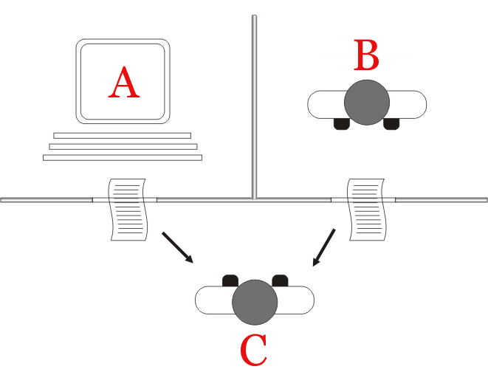
Turing Test - Philosophical A.I. Debate
Imitation Game
Easier than determining thinking
Does not determine intelligence
Thinking of modern computing
What is a good way to do this test?
Hint: look at your phones
CHAT BOTS!
Jabberwacky being a prize winner.
Additional Reading: Chatbots Past and Future
By Juan Alberto Sánchez Margallo [CC BY 2.5 (https://creativecommons.org/licenses/by/2.5)], via Wikimedia Commons

Slide 4
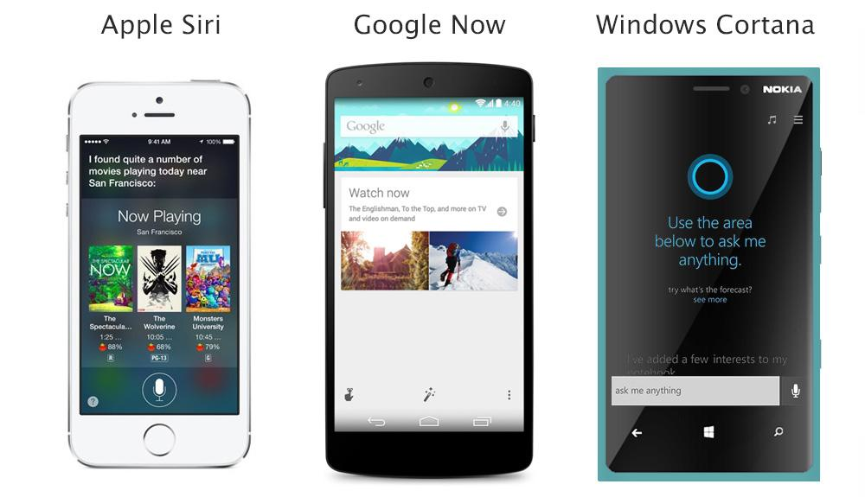
Famous Tech Based on Chatbots?

Slide 5

Caesar Cipher
Sentence: ABB
Shift it 1 place: BCC
Decoding - pretty easy to figure out by running all combinations
BUT - 159 quintillion combinations?
That would be much harder
Public domain image by Matt Crytpo http://en.wikipedia.org/wiki/File:Caesar3.png

Slide 6
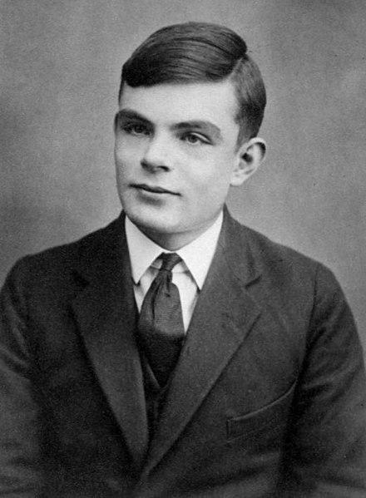
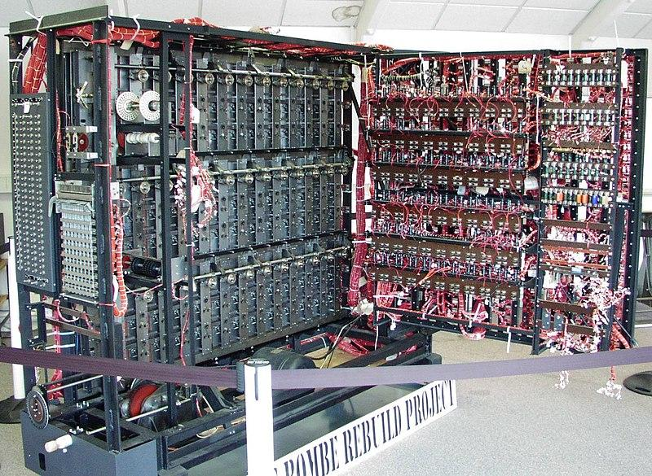

Alan Turing
Mathematician and Philosopher
Enigma Code Breaker - Bombe Machine
Series of interlocking wheels
Looked at all combinations
WWII Hero has a great interactive example
Turing Machine
Analog theoretical computer
We have ‘close approximations’
Turing Test
Imitation Game
Thinking is hard to define
Later life
Chemical Castration (DES)
Died age 41 from Cyanide poisoning
Queen pardoned him of ‘crimes’ - 2013
See page for author [Public domain], via Wikimedia Commons
Replica of Bombe Machine
Photographer: Tom Yates. Source
Additional Reading: WWII Hero

Slide 7
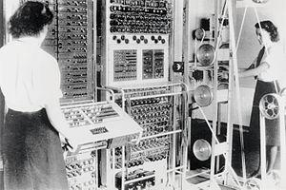
Who Programmed the Bombe?
Jean Valentine
Along with many others
Colossus machines
Call “Wrens”
Worked in parallel with the bombe
Woman programmed them
Considered “unskilled labor”
To the point of morning revelry
Mostly lost to history due to security restrictions
Many were not allowed to continue in computing.
Cryptographers were men, programmers were women
See page for author [Public domain], via Wikimedia Commons

Slide 8
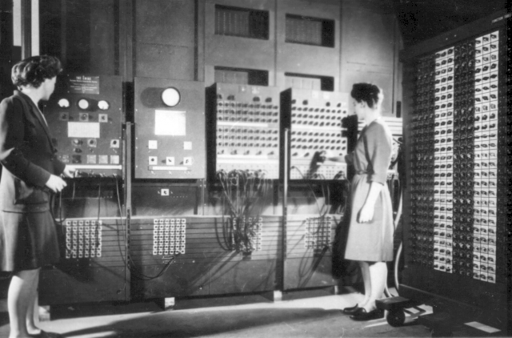
World War II - USA
Electronic Numerical Integrator and Computer (ENIAC)
The ‘silent’ programmers
Jean Jennings (Bartik)
Betty Snyder (Holberton)
Frances Bilas (Spence)
Kay McNulty (Mauchly Antonelli)
Marlyn Wescoff (Meltzer)
Ruth Lichterman (Teitelbaum).
Was considered “unskilled” labor
degrees in mathematics.
After the war?
They continued on after, had more, but limited freedom.
Defined the field
Changed the world
Programmers Betty Jean Jennings (left) and Fran Bilas (right) operate ENIAC's main control panel
By United States Army (Image from http://ftp.arl.army.mil/~mike/comphist/) [Public domain], via Wikimedia Commons

